Slide 1
Big Mountain Resort
Danny Huang

Slide 2
Problem Identification
Big Mountain Resort has invested in a new chair lift in order to increase visitor distribution across the mountain.
This additional chair lift increase operating cost by $1,540,000 this season.
Management believes that we could be generating more income by increasing ticket prices but we need to find some justification in doing so. Currently tickets pricing are based on just the market average and that does not provide the business with a good sense of how important some facilities are compared to others. The business wants some guidance on how to select a better value for their ticket price in order to offset the initial investment.

Slide 3
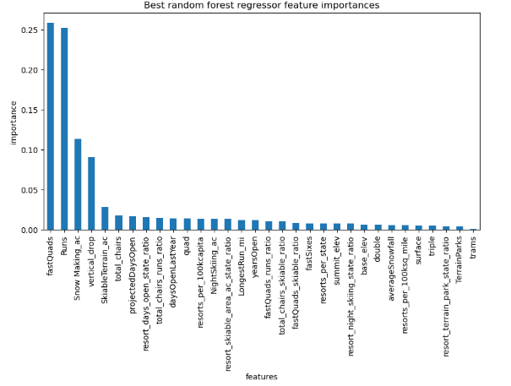
Problem Statement
How can we use data from other resorts to accurately price tickets at Big mountain resort to offset the 1.5 million investment of the new chair lift by next season?
We are focusing on our facilities, comparing and utilizing data of all resorts in the nation to justify increase ticket costs. We are going to create models using national resort data to compare tickets prices and facilities. Using that data, we’re going to apply that to our pricing model. Using this model, we could not only identify ticket accurate ticket pricing, but also see which facilities is not being fully utilized. Potentially cutting costs on some operations without undermining the ticket price.
We are going to create a random forest model.
These are the features that were sought to be most important in determining ticket prices.
- fastQuad - # of fast quad chair lifts
- Runs - # of runs the resort has
- SnowMaking_ac – Acres of man-made snow

Slide 4
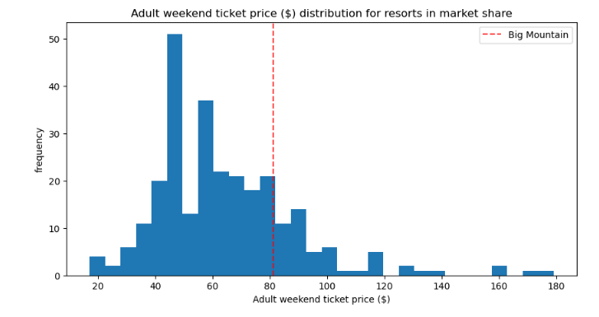
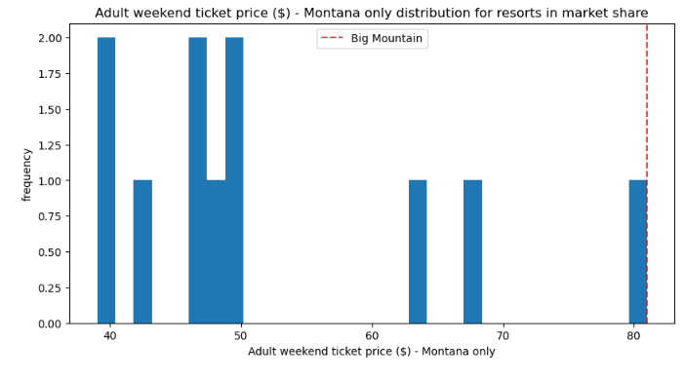
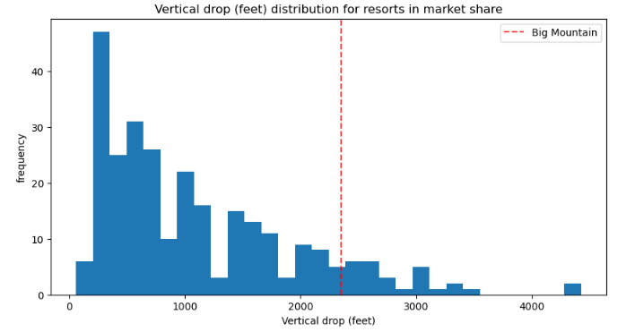
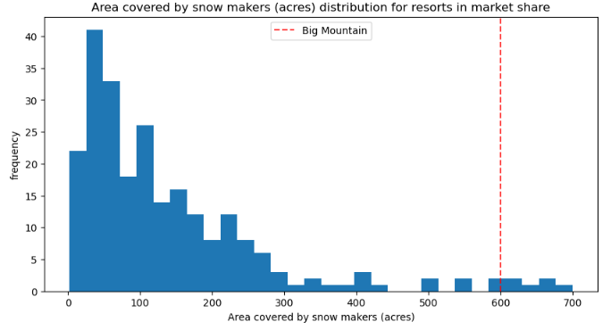
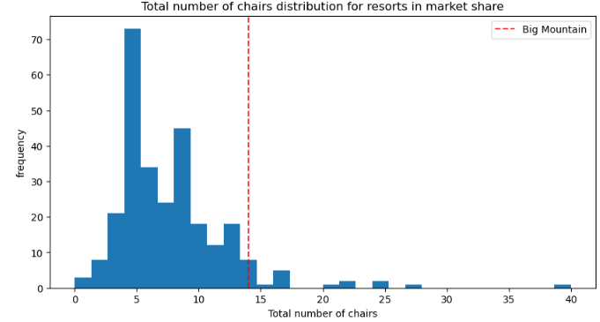
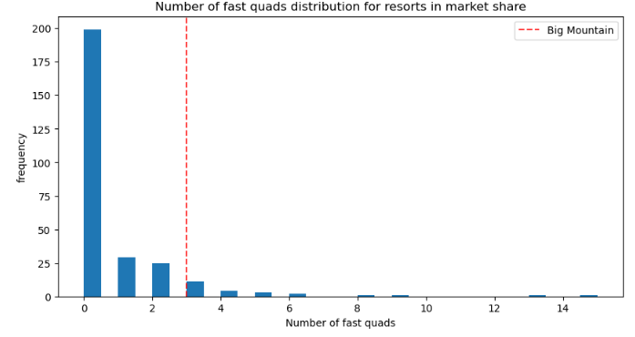
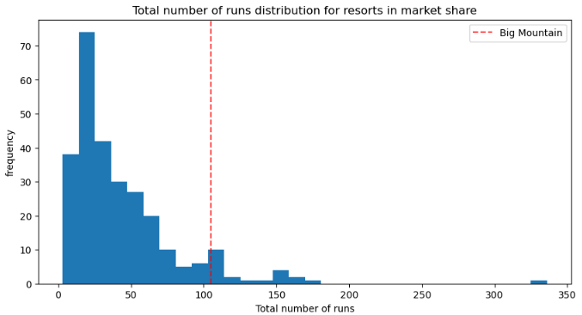
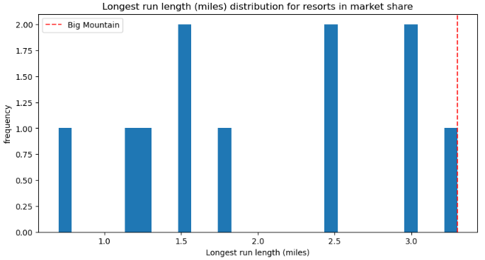
Ticket price suggestion
After running our model using dataset with and without Big Mountain resort. It was determined that the modelled suggested price of a ticket is $95.87, the original price is $81, an increase of about $15 more. The expected mean absolute error of $10.39, which would suggest there is room for an increase.
While compared to other resorts in the nation, we see that Big Mountain prices are a bit above average. Compared to other resorts in Montana, we see that it’s actually the most expensive.
We see that this is warranted, when you take a look at the facilities and features that Big Mountain has to offer. For the most part it’s above the curve in most cases. Supporting the increase of the ticket even more.

Slide 5
Modelling Scenarios
Big mountain resort has been also reviewing potential scenarios for either cutting costs or increasing revenue. We are able to use our model to tweak resort parameters to simulate these provided scenarios. Business leader had provided us 4 scenarios:
1. Permanently closing down up to 10 of the least used runs. This doesn't impact any other resort statistics.
2. Increase the vertical drop by adding a run to a point 150 feet lower down but requiring the installation of an additional chair lift to bring skiers back up, without additional snow making coverage
3. Same as number 2, but adding 2 acres of snow making cover
4. Increase the longest run by 0.2 mile to boast 3.5 miles length, requiring an additional snow making coverage of 4 acres

Slide 6
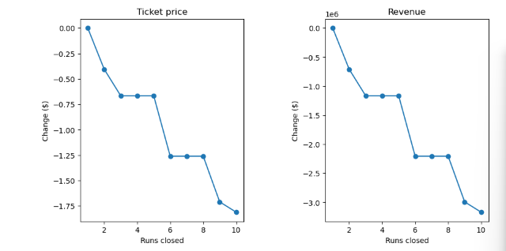
Modeling Scenario 1:
Permanently closing down up to 10 of the least used runs. This doesn't impact any other resort statistics.
Model suggests that closing one run makes no difference. Closing 2 and 3 reduces the support for ticket prices. Closing 3 also further decreases supports but no further loss in ticket price if 4 and 5 are also closed. Does not make sense to close more than 5 cause the drop ticket price becomes very significant.

Slide 7
Modeling Scenario 2 + 3
Increase the vertical drop by adding a run to a point 150 feet lower down but requiring the installation of an additional chair lift to bring skiers back up, without additional snow making coverage
Model suggest that in this scenario, that there is increase support for ticket price by $8.61, over the next season (assuming expected visitors of 350k) returns $15,065,471 in revenue.
Increase the vertical drop by adding a run to a point 150 feet lower down but requiring the installation of an additional chair lift to bring skiers back up, with the additional of 2 acres of snow making.
Model suggests that with the previous scenario in mind and an additional 2 acres of snow making, will further increase the previous model support for ticket price by $0.71, resulting in $9.90 overall ticket price and expected return of $17,322,717

Slide 8
Modelling Scenario 4
Increase the longest run by 0.2 mile to boast 3.5 miles length, requiring an additional snow making coverage of 4 acres
Model suggest no difference. However, in terms of marketing we can advertise longest run in Montana which could drive increase visitor count. The model cannot determine the effectiveness of advertising this feat so we would not recommend this without further investigations.

Slide 9
Summary
We suggest to raise ticket prices to $95.87, $96 rounded. We could also further increase it by $10.39. If we decide to do this, visitors may be turned off by the high unexpected jump of prices. So we would further suggest to slowly increment the increase of ticket price through seasons if decided to push prices pass 96$.
Scenarios:
We would suggest to close 1 run since it doesn’t impact ticket price.
We would also suggest either scenario 2 or 3, Increase the vertical drop by adding a run to a point 150 feet lower down but requiring the installation of an additional chair lift to bring skiers back up. With or without additional snow making coverage. There will be more investments needed but we could easily boost ticket prices even further by $8.61 and $9.90, without and with snow making coverage respectively.

